Slide 1


Slide 2

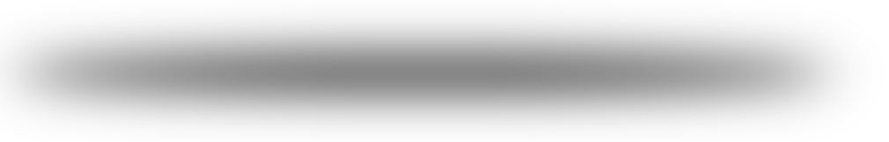
MOVIE ANALYSIS
PROJECT: WEB SCRAPING WITH EDA
DOMAIN: FILM INDUSTRY
TITLE: TOP RATED MOVIES IN THE WORLD

Slide 3
OUR TEAM
REVELLI RAMANA
ADITI PAWAR
Batch No : 147, Innomatics Research Labs, Hyderabad

Slide 4
Name : Revelli Ramana
UG : BSc MSCs[Mathematics , Statistics , Computer Science]
Pass out Year : 2021
Name : Aditi Pawar
UG : B.Tech [ Electronics and Telecommunication Engineering]
Pass out Year : 2020

Slide 5

LIBRARIES USED IN PROJECT
01
02
03
BEAUTIFULSOUP
REQUESTS
NUMPY
04
05
06
PANDAS
MATPLOTLIB
SEABORN
Beautiful Soup is a Python package for parsing HTML and XML documents
Requests will allow you to send HTTP requests using Python
NumPy is a Python library used for working with arrays
Pandas is a Python library for data analysis.
Seaborn is a library for making statistical graphics in Python.
Matplotlib is a comprehensive library for creating static, animated, and interactive visualizations in Python.

Slide 6

STEPS INVOLVED IN THIS PROJECT
01
02
INTRODUCTION
PROBLEM
STATEMENTS
03
04
DATA SCRAPING
DATA CLEANING
05
06
EDA
CONCLUSION

Slide 7


01
INTRODUCTION

Slide 8
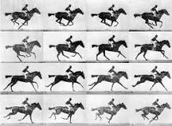
Roundhay Garden Scene
1888. In Leeds, England Louis Le Prince films Roundhay Garden Scene, believed to be the first motion picture recorded.
It's a short film directed by French inventor Louis Le Prince.
Running time - 1.66sec
Country – United Kingdom
Language - Silent

Slide 9
- In this project first we used Beautifulsoup library to scrap the data. - For that we used IMDB website as our source url. - As per our need we scrape the data and convert it into DataFrame - After creating the dataframe we stored it into csv file. - As the scraped data consists of raw entries and null cells, we clean the data using Numpy and Pandas libraries - Now, with the cleaned data we had visualized the data using EDA(Exploratory Data Analysis)

Slide 10

02
PROBLEM STATEMENTS

Slide 11
1) Find the count of ratings of the movies.
2) Most watched movies as per certificate.
3) Certificate v/s Metascore.
4) Certificate v/s Ratings.
5) Genre v/s votes.
6) Top 20 movies according to there collection.
7) Comparison of Genre and Title with Votes.

Slide 12

03
DATA SCRAPING
USING BEAUTIFULSOUP

Slide 13
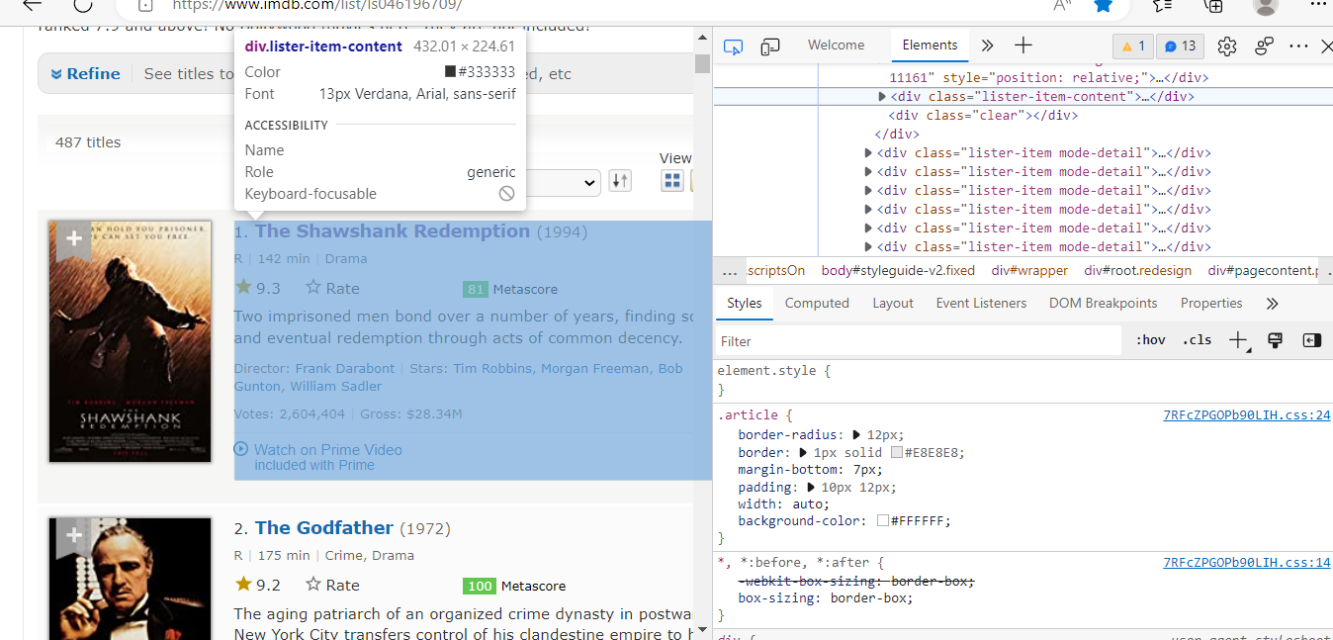
DATA EXTRACTION
SOURCE :- IMDB Top 500+ - IMDb

Slide 14
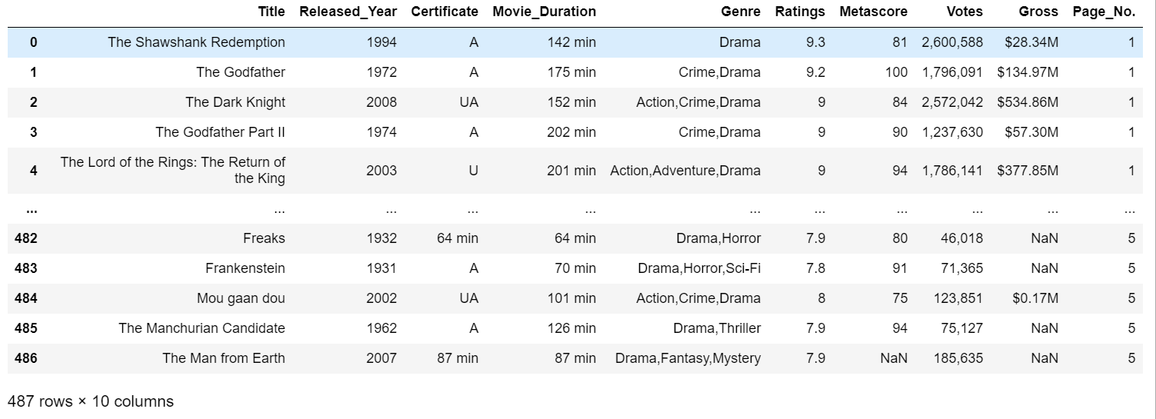
SCRAPED DATA
RESOURCES
+ BEAUTIFULSOUP
+ NUMPY
+ PANDAS
+ DATA FRAME

Slide 15


04
DATA CLEANING

Slide 16
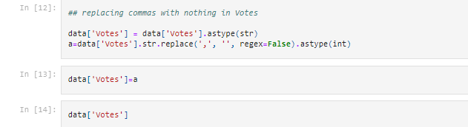
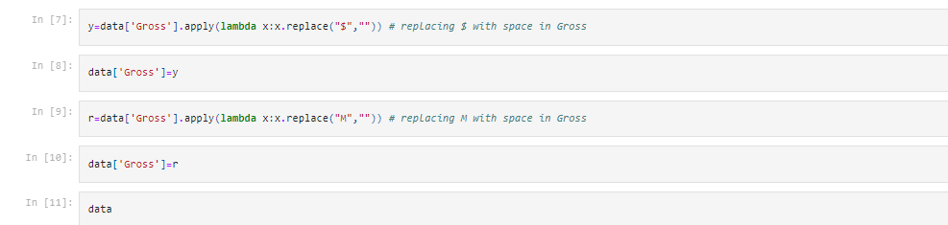

Slide 17
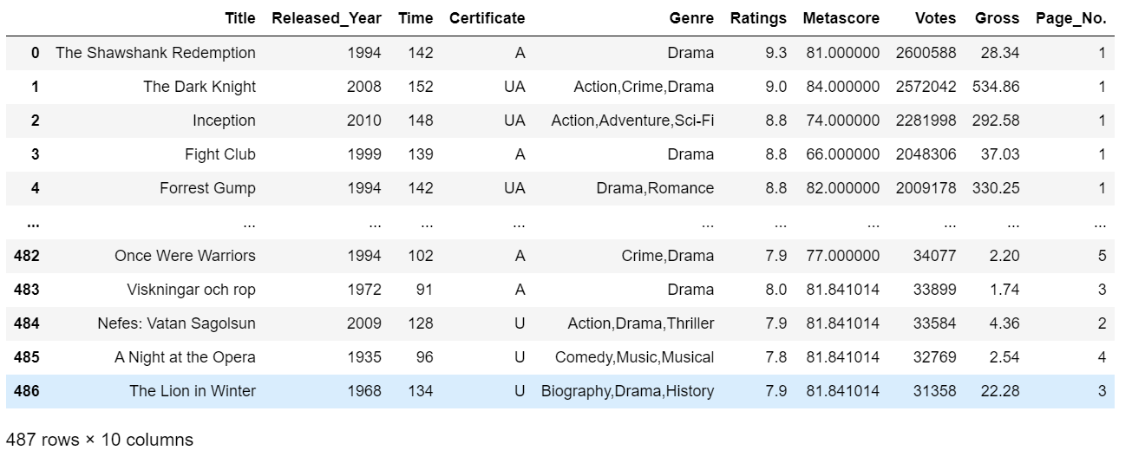
CLEANED DATA:-
RESOURCES:
+ NUMPY + PANDAS + DATA FRAME
!

Slide 18
CHALLENGES FACED
Finding the HTML tags to scarp the data.
While cleaning the data we got hold of unwanted data and replaced with required data.
Replacing all NAN(not a number) values with mean and mode.
To get accurate figure size while visualization of the data.

Slide 19

05
(EDA) EXPLORATORY DATA ANALYSIS
USING MATPLOTLIB AND SEABORN.

Slide 20
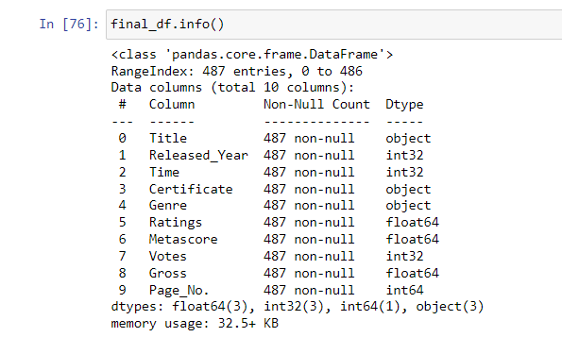
Insight:
The info() method gives the information of the data
This shows names and number of columns
There are no null values
Released_Year,Time,Page_No and Votes are in int data types.
Ratings,Metascore and Gross are in float data type.
And all other columns are of String Data type

Slide 21
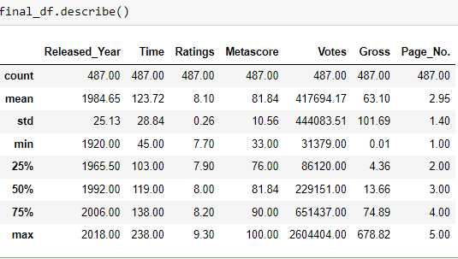
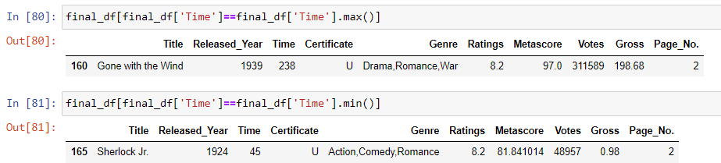
Insights
Min of Time in minutes is 45min
Max of Time in minutes is 238min
50% of Ratings is 8.00
Max of Votes is 2604404
75% of Metascore is 90

Slide 22
1) COUNT OF RATINGS OF THE MOVIES

Slide 23
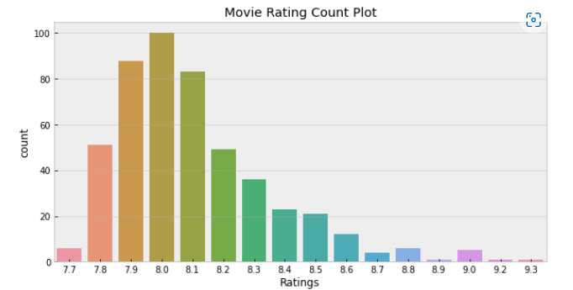
Insight :
In this data frame the movies which are rated 8.0 are more.
8.9 , 9.2 , 9.3 rated movies are very less

Slide 24
2)Most watched movies as per Certificate

Slide 25
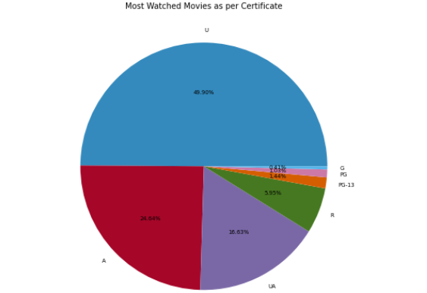
Insight :
In this pie chart we can observe that U Certified movies are more.
And A Certified movies are second highest
G,PG and PG-13 seems to have very less viewers.

Slide 26
3)Certificate v/s Metascore

Slide 27
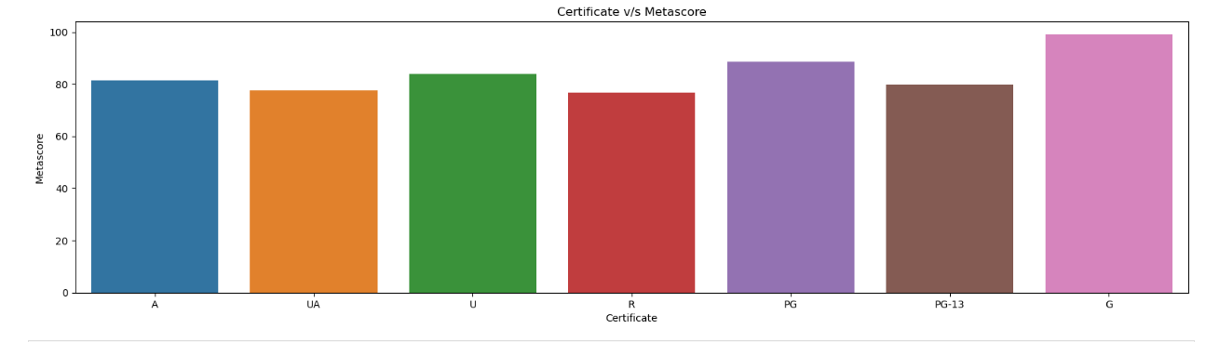
Insight :
From this plotting we absorve that G rated movies have more meta score, compared to thar of other rated movies

Slide 28
4)Certificate v/s Ratings

Slide 29
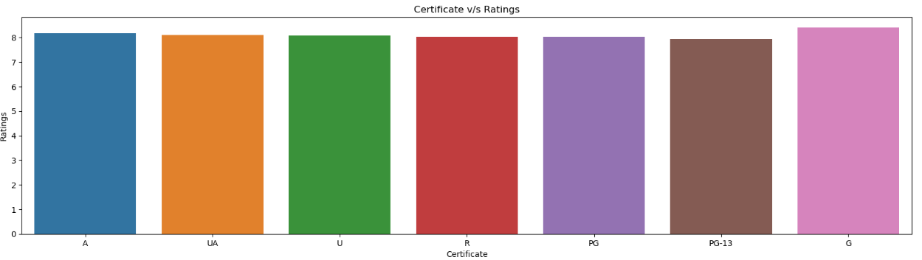
Insight :
In this graph there seems to be a very slight difference between G certified and other certified movies.
But G has higher ratings.

Slide 30
5)Genre v/s Votes

Slide 31
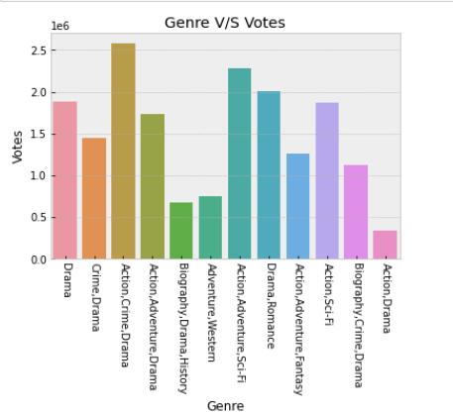
Insight :
This plot shows that which combination of genre movies people mostly prefer to watch.

Slide 32
6)Top 20 Movies according to there Collections

Slide 33
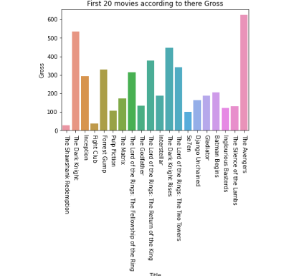
Insight:
This shows that ‘The Avengers’ has done much better at box office compared to other movies

Slide 34
7) Correlation between Numerical columns.Votes.

Slide 35
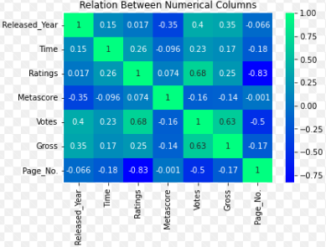
Insight :
Ratings are directly proportional to Votes.
Votes are directly proportional to Gross.

Slide 36

06
CONCLUSION

Slide 37
Overall we can say that ratings of many movies are 8.0
8.9 , 9.2 , 9.3 rated movies are very less
We could say that most watched movie is “The Avengers”
Most of the top rated movies are U certified (i.e under restricted public exhibition)
And people around the world likes to watch Action,Crime,Drama based movies.

Slide 38


Thanks!

Slide 39

A PICTURE IS WORTH A THOUSAND WORDS

